Slide 1
with Catarina Miranda, Kyle Shroer, Phaedra Walton, Stephanie Sears, & Naomi Abbey
Notes:
Picture:
http://1.bp.blogspot.com/_wJ0Q8cuxCJg/SwwCKS2djLI/AAAAAAAAA9s/_XYr0mnbZBg/s1600/pine+trees.gif

Slide 2
Our Fun Adventure
Notes:
Picture: http://www.bestlandscapeideas.net/trees/

Slide 3
Early one fall morning, Ms. Whitley’s class decided to go for a walk through the forest.
Notes:
Picture: http://1.bp.blogspot.com/_wJ0Q8cuxCJg/SwwCKS2djLI/AAAAAAAAA9s/_XYr0mnbZBg/s1600/pine+trees.gif

Slide 4
Sunrise/sunset pose
Notes:
1. Stand up tall. Take three to five deep breaths. 2. On the next inhale, lift your arms above your head. Press your legs and feet down toward the ground and stretch your spine and waist toward the sky.

Slide 5
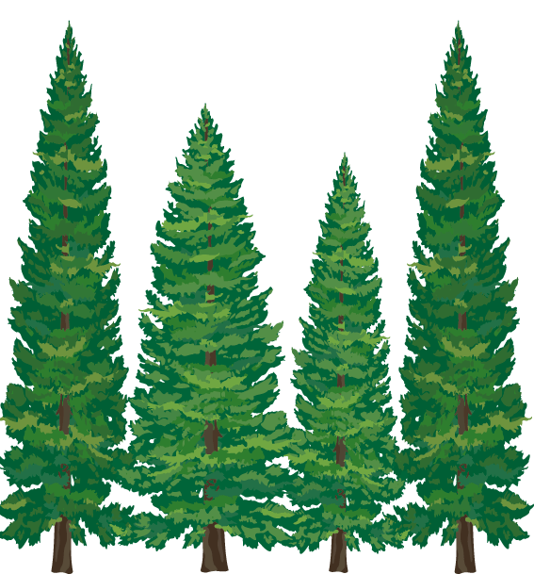
In the forest there were so many tall pine trees.
Notes:
Picture: http://stay-at-homemomwhoknew.blogspot.com/2009_11_01_archive.html

Slide 6
Tree Pose
Notes:
1. Stand up straight and tall. Breathe in and out and feel your legs reaching toward the ground and your head reaching toward the sky. Look at one spot in front of you to keep your eyes steady. 2. Now lift your right leg by bending your knee. Breathe evenly, looking at one spot in front of you. Place your right leg on your left leg, above the knee (or below the knee if that's more comfortable). Imagine roots growing from your left foot into the ground. Let your left leg be strong like the trunk of the tree. Now stretch your arms up like branches. Don't worry if you start to fall; just smile and start again from the beginning.

Slide 7
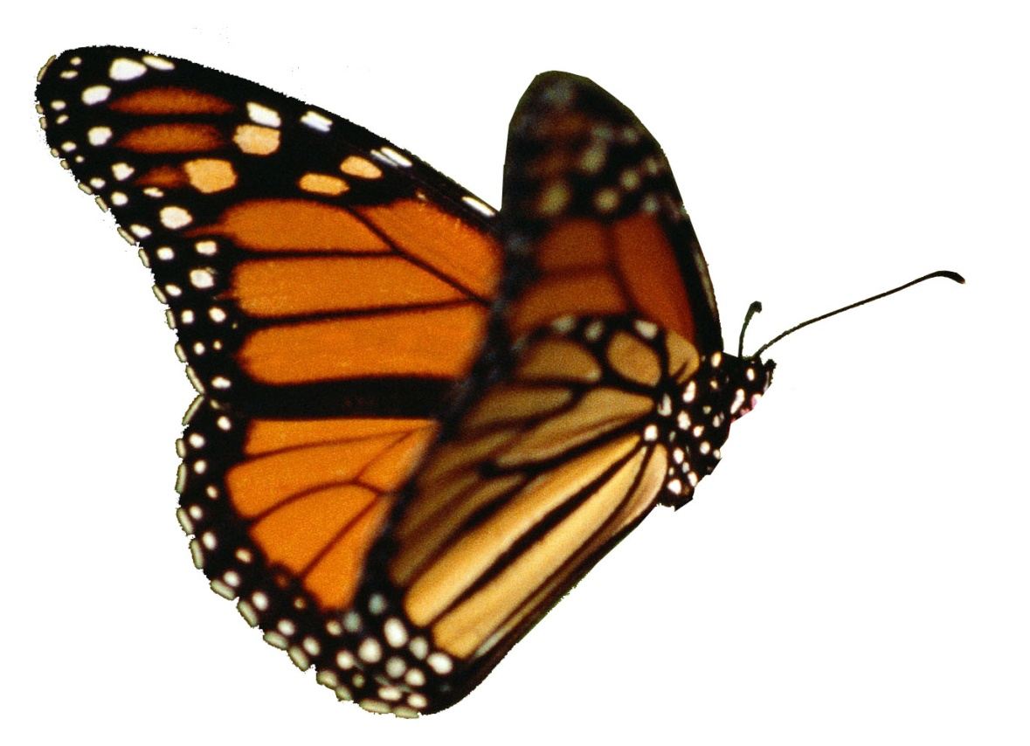
On top of one of the trees there was an butterfly with big beautiful wings.
Notes:
Picture: http://suz143.wordpress.com/2011/09/09/the-butterfly-effect/

Slide 8
Butterfly Pose
Notes:
1. Sit on the floor and place the soles of your feet together. Hold on to your feet or ankles, and let your knees drop toward the floor. Sit up with a tall spine. 2. Imagine that you are a butterfly with beautiful wings stretching out from your spine and with long antennae reaching out from your head. Ideas: Make a butterfly painting. Fold a piece of paper in half and then draw the same design on both sides, for the wings. Color or paint the designs and cut out the butterfly. Put a string on it and hang it from the ceiling, and watch the butterfly move in the breeze.

Slide 9
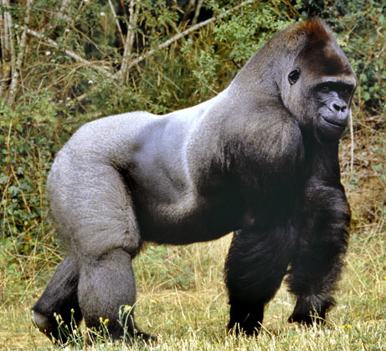
As we continued walking through the forest we came to a mountain. We started climbing it and saw a gorilla.
Notes:
Picture: http://animal-wildlife.blogspot.com/2011/08/western-lowland-gorilla.html

Slide 10
Gorilla Pose
Notes:
Stand with your legs wide apart. Bend forward at the waist, bending your knees a little bit. Let your arms hang down in front of you and swing your upper body back and forth like a gorilla. You can also just hang forward over your legs without swinging. Ideas: Try walking side to side and back and forth with heavy feet like a big gorilla. Take a big breath in and stand up. As you lean back, beat your fists on your chest and make a big gorilla noise! Draw a picture of a family of gorillas in the jungle.

Slide 11
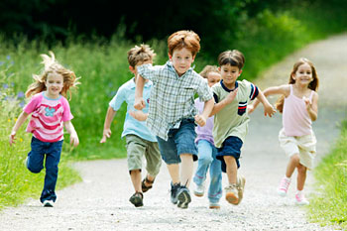
When the gorilla saw us it started chasing us! The only was to escape was to cross a long bridge.
Notes:
Picture: http://blog.jeffersonatwesttown.lincolnapts.com/health-fitness/west-chester-health-kids-running-series/

Slide 12
Partner bridge pose
Notes:
Stand up facing a friend with enough space between you to bend forward. Take hold of each other's hands or wrists. Bend forward at the waist until you are both stretching your backs long and straight. You will each pull a little bit, but not so much that you fall over. It might take a few tries to balance! You might need to bend your knees. 2. When you are in Partner Bridge pose, breathe slowly in and out. Try to listen to your partner's breathing also. 3. When you are ready to come up, stand up slowly and carefully. Thank your partner.

Slide 13
After we crossed the long bridge we were so tired we caught our breath just in time for...
Notes:
Yoga Poses: http://www.parents.com/fun/activities/indoor/yoga-for-kids/

Slide 14
MATH CLASS!!!
Notes:
Pictures of yoga poses and instruction: http://www.parents.com/fun/activities/indoor/yoga-for-kids/

